Slide 1
Smart Woman Securities Introduction Meeting
smartwomansecurities
September 8, 2016

Slide 2
about us

Slide 3
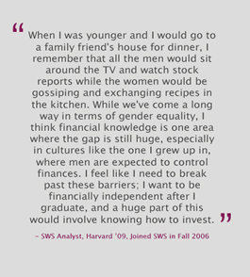
Why SWS?

Slide 4
Our Mission
Smart Woman Securities (SWS) seeks to provide undergraduate women with the skills necessary to make investment decisions through market education, exposure to industry professionals, and real-world financial experience.
The core purpose of SWS is to educate young women about investing in the financial markets through educational seminars and direct investment experience.
Notes:
Speak a little bit about each of these tools, and what kind of risk or return that they offer.

Slide 5
Our Model

Slide 6
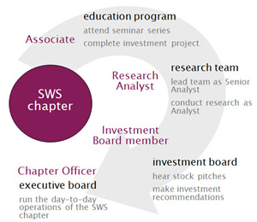
Our Chapter

Slide 7
what will SWS do?
Weekly educational seminars
Mentorship programs with professionals
Practical experience in investing, managing a portfolio, and much more!
SWS isn’t a one-off class about personal finances and how to fill out your taxes and 401k forms (although that’s important as well!)… We are trying to give you a platform in which you can use to learn more about investing and managing your finances. We are learning, just as you are!

Slide 8
what we don’t do
We don’t tell you how to manage your money
We don’t tell you what to invest in
Our focus is on empowering you to make investment decisions that are best for you.
We want to give you options to make your own choices about your portfolio.
In the future, you may decide that investing in individual stocks is too risky of an investment… however, how will you ever know what you prefer until you actually invest?
* - CNN.com

Slide 9
educational seminars

Slide 10
educational seminars
The education seminars are designed to provide you with a broad introduction to investing. Each week, we will build on the previous curriculum.
The curriculum has been designed by the SWS team with the help of industry professionals and individual investors. The seminars have been created especially for undergraduate students from a liberal arts background.
Although we can’t learn everything about investing in 10 weeks, the seminars are intended to give you a platform upon which you can build knowledge and learn more about investing in a comfortable community setting.

Slide 11
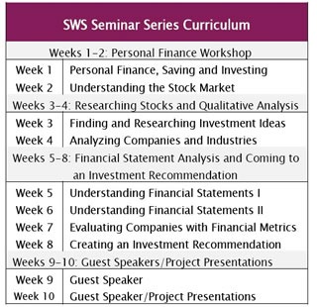
educational seminars

Slide 12
educational seminars
80% attendance (8/10 lectures)
If you must miss more than 2 lectures, please contact us prior to your absence and let us know.
Thursdays, 5-6 PM, Simon Auditorium, Tepper
Quizzes

Slide 13
New Member Lecture Series Dates
September 15: Personal Finance Savings & Investing
September 22: Understanding the Market
September 29: Finding & Researching Investment Ideas
October 6: Analyzing Companies & Industries
October 13: Understanding Financial Statements I
October 27: Understanding Financial Statements II
November 3: Evaluating Companies with Financial Metrics
November 10: Creating an Investment Recommendation
November 17: Guest Speaker Event
December 8: Guest Speaker Event

Slide 14
investment project
In addition to attending all seminars, SWS Associates will be required to complete an investment project.
The project will involve researching a publicly-traded company of your choosing in depth.
You will use your knowledge from seminars and complete further research in the industry.
The semester will culminate with investment recommendations.

Slide 15
investment project deadlines
September 29: Pick publicly-traded company
October 13: Company overview
October 20: Competitor Analysis
November 3: Financial Statement Analysis
November 10: Evaluate with Financial Metrics, Opportunities, and Threats
November 17: Final Recommendation
December 8: Final Project

Slide 16
why should I join?

Slide 17
learning about investing
Planning for your future
Financial independence
General knowledge
Personal interest
When asked about when women should start learning about investing, Professor Mahnaz Mahdavi of Smith College said, "College is the right time for people to start thinking about this. It's the first time the majority of people become independent, move away from home. Even if their parents are giving them money, they're the ones who have to manage it."

Slide 18
why should I join SWS?
Educational platform in which to learn more about investing
Access to senior executive-level mentors
Opportunities for company visits and dinners with representatives throughout the semester and into the spring.
Chance to gain practical experience in the investment fund
Join a community of like-minded women

Slide 19
Q&A

Slide 20
cmu.sws@gmail.com carnegiemellonsws.com

