Slide 1
Analyzing Companies and Industries
Angela Kohler
October 8, 2015

Slide 2
Analyzing Companies & Industries
Analyze the Industry First: Provides Framework for the Estimates & Assumptions Used in Company Analysis
Top-Down Analysis

Slide 3
Analyzing Industries
Economic Cycle Analysis
Industry Life Cycle
Porter’s Five Forces
Industry Framework

Slide 4
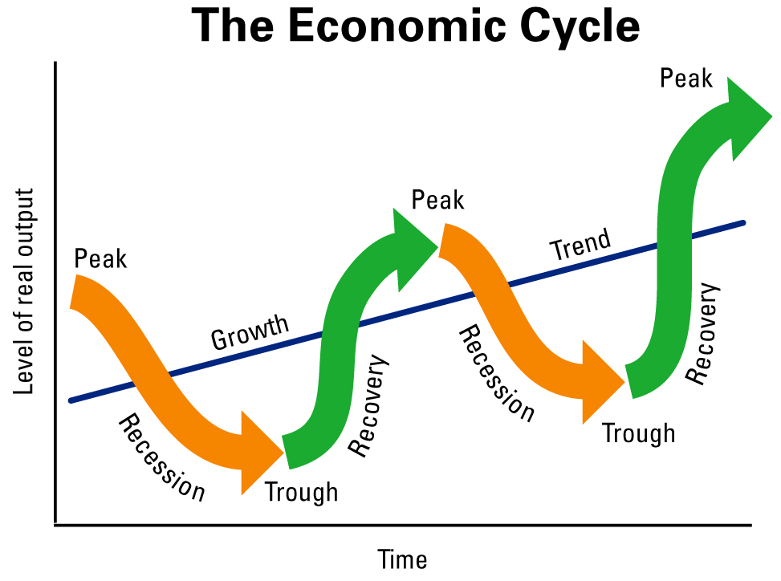
Analyzing Industries: Economic Cycle Analysis
Identify Current Stage in Economic/Business Cycle:

Slide 5
Analyzing Industries: Economic Cycle Analysis
Characteristics of Economic Cycle Stages:
 | Recovery | Peak | Recession | Trough
Growth (GDP, IP, jobs, incomes) | Rebounds | Peaks | Declines | Troughs
Credit | Growing | Tightens | Dries Up | Troughs
Corporate Profits | Rapid growth | Peaks | Declines | Troughs

Slide 6
Analyzing Industries: Economic Cycle Analysis
Typical Asset Class Behavior During Economic Cycle Stages:
 | Recovery | Peak | Recession | Trough
Stocks | Increase | Decline | Decline | Increase
Bonds | Decline | Decline | Increase | Increase
Commodities | Increase | Increase | Decline | Decline

Slide 7
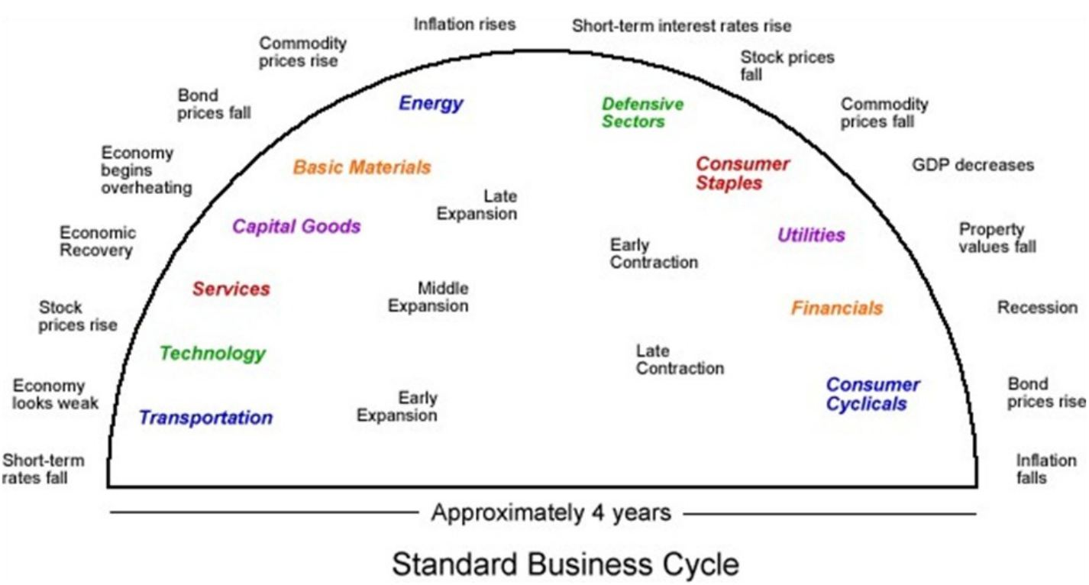
Analyzing Industries: Economic Cycle Analysis
Traditionally Attractive Industries During Economic Cycle Stages:

Slide 8
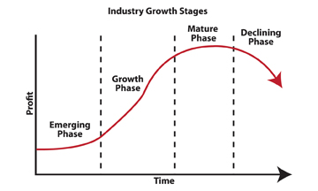
Analyzing Industries: Industry Life Cycle

Slide 9
Analyzing Industries: Industry Life Cycle
Emerging Phase:
Product/Service Concept in Development
Market Demand Uncertain
Many Small Industry Participants
Speculative, High-Risk, Large Investment Requirements
Manufacturing and Marketing Inefficiencies
Typical Customer is Early Adopter
High Asset Valuations

Slide 10
Analyzing Industries: Industry Life Cycle
Growth Phase:
Significant Product/Service Improvement
Market Acceptance
Fewer Market Participants, with Established Share
Industry Capacity Growing & Distribution Partners Expanding
Economies of Scale
Customers are Early Majority
High Asset Valuations

Slide 11
Analyzing Industries: Industry Life Cycle
Mature Phase:
Product/Service has incremental improvements
Industry Dominated by a Few Big Players
Sales Deceleration, with Supply & Demand Equilibrium
Customers are Late Adopters
Moderating Valuations

Slide 12
Analyzing Industries: Industry Life Cycle
Declining Phase:
Industry Participants Focused on Cost Efficiencies
Less Players as Demand Wanes
Sales & Profit Contraction
Potential Replacement by New Product or Technology
Typical Customers are Laggards
Low Valuation
Product Expansion, If Possible, Can Lead to Reacceleration

Slide 13
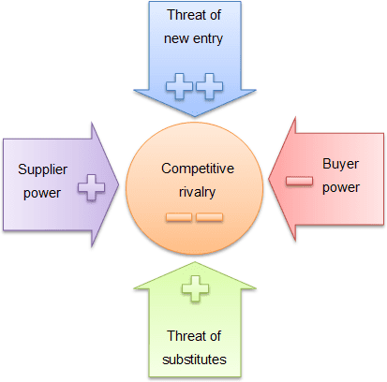
Analyzing Industries: Porter’s Five Forces

Slide 14
Analyzing Industries: Porter’s Five Forces
Threat of New Entry:
- Time, Cost, & Expertise to Enter
- Economies of Scale
- Access to Distribution & Technology
Buyer Power:
- Number of Customers
- Differentiation/Brand Identity
- Switching Costs
Supplier Power:
- Number and Size of Suppliers
- Uniqueness of Product/Service
- Switching Costs

Slide 15
Analyzing Industries: Porter’s Five Forces
Threat of Substitute:
- Availability, Price, & Quality of
Alternatives
Switching Costs
Competitive Rivalry:
- Number of and Diversity of Competitors/Industry Concentration
- Differentiation
- Regulation, Import Protection

Slide 16
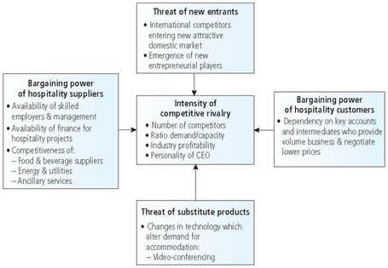
Analyzing Industries: Porter’s Five Forces
Example: Hotel Industry

Slide 17
Analyzing Industries: Industry Framework
Gather Historical Industry Growth Data*
Analyze Key Drivers of Historical Growth
Integrate Historical Data and Position in Economic Cycle, Industry Cycle, and Porter’s Five Forces Analysis to Project Future Growth
*Sources of Data:
Industry Associations
Trade Journals & Associations
Company Annual Reports/10-Ks

Slide 18
Analyzing Industries: Industry Framework
Examples of Historical Industry Growth Data:
North American Vehicle Production
 | PROD | Canada | Canada | Canada | Mexico | Mexico | Mexico | U.S. | U.S. | U.S. | U.S. | N.A. | N.A. | N.A. | GRAND
 | NA | Car | LTruck | M/H Truck | Car | LT | M/H Truck | Car | LT | Light Veh | M/H Truck | LT VEH | LT Truck | Med & Heavy | TOTAL
 | 1/1985 | 84,290 | 77,557 | 1,785 | 23,316 | 14,738 | 2,308 | 761,904 | 255,241 | 1,017,145 | 22,549 | 1,217,046 | 347,536 | 26,642 | 1,243,688
 | 2/1985 | 79,298 | 70,245 | 1,814 | 24,189 | 14,311 | 2,117 | 673,583 | 253,305 | 926,888 | 22,715 | 1,114,931 | 337,861 | 26,646 | 1,141,577
 | 3/1985 | 80,378 | 77,025 | 1,913 | 24,480 | 14,582 | 2,581 | 747,361 | 268,214 | 1,015,575 | 25,455 | 1,212,040 | 359,821 | 29,949 | 1,241,989
 | 4/1985 | 94,808 | 76,325 | 1,917 | 22,617 | 12,792 | 2,730 | 757,754 | 272,664 | 1,030,418 | 25,562 | 1,236,960 | 361,781 | 30,209 | 1,267,169
 | 5/1985 | 106,528 | 78,744 | 1,938 | 24,038 | 16,470 | 2,325 | 776,817 | 299,782 | 1,076,599 | 27,443 | 1,302,379 | 394,996 | 31,706 | 1,334,085
 | 6/1985 | 99,804 | 75,363 | 1,826 | 22,976 | 11,695 | 2,212 | 694,132 | 277,374 | 971,506 | 24,397 | 1,181,344 | 364,432 | 28,435 | 1,209,779
 | 7/1985 | 67,414 | 50,391 | 1,275 | 27,081 | 14,608 | 2,036 | 618,478 | 214,446 | 832,924 | 18,457 | 992,418 | 279,445 | 21,768 | 1,014,186
 | 8/1985 | 87,679 | 56,115 | 1,361 | 19,298 | 13,757 | 1,799 | 550,528 | 269,446 | 819,974 | 21,137 | 996,823 | 339,318 | 24,297 | 1,021,120
 | 9/1985 | 91,463 | 71,230 | 1,407 | 18,034 | 13,002 | 1,797 | 635,331 | 267,861 | 903,192 | 21,822 | 1,096,921 | 352,093 | 25,026 | 1,121,947
DEPARTMENT OF DEFENSE BUDGET
 | 2004 |  | 2005 |  | 2006 |  | 2007
 | $ | % | $ | % | $ | % | $ | %
CORE
Investment Accts (a.) | 140,399 | 10.8% | 146,916 | 4.6% | 149,711 | 1.9% | 156,381 | 4.5%
Other (b.) | 225,833 | -0.4% | 243,137 | 7.7% | 248,995 | 2.4% | 267,822 | 7.6%
DoD Budget | 366,232 | 3.6% | 390,053 | 6.5% | 398,706 | 2.2% | 424,203 | 6.4%
Non DoD Items (c.) | 9,433 | -10.1% | 10,005 | 6.1% | 12,010 | 20.0% | 11,274 | -6.1%
Total Core Budget | 375,665 | 3.2% | 400,058 | 6.5% | 410,716 | 2.7% | 435,477 | 6.0%

Slide 19
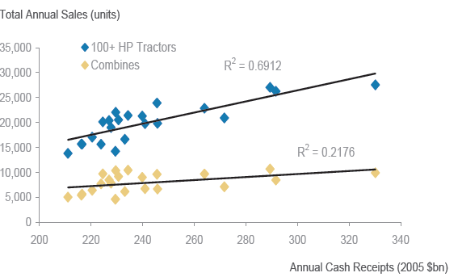
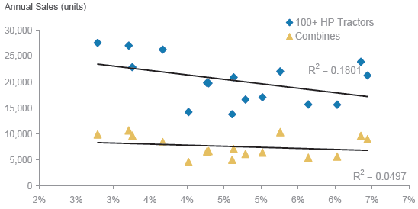
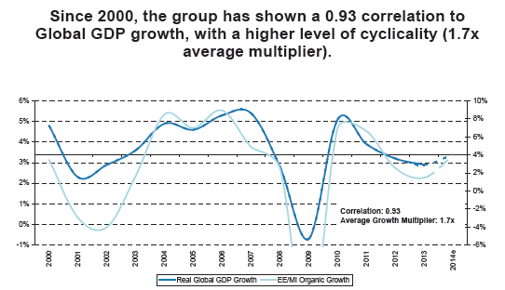
Analyzing Industries: Industry Framework
Examples of Identifying Key Drivers of Growth:
Annual Cash Receipts are a Much Better Indicator of Future Tractor Sales than Interest Rates:
EE/MI Growth and Global GDP are Highly Correlated, as are Advertising Growth & Nominal GDP:

Slide 20
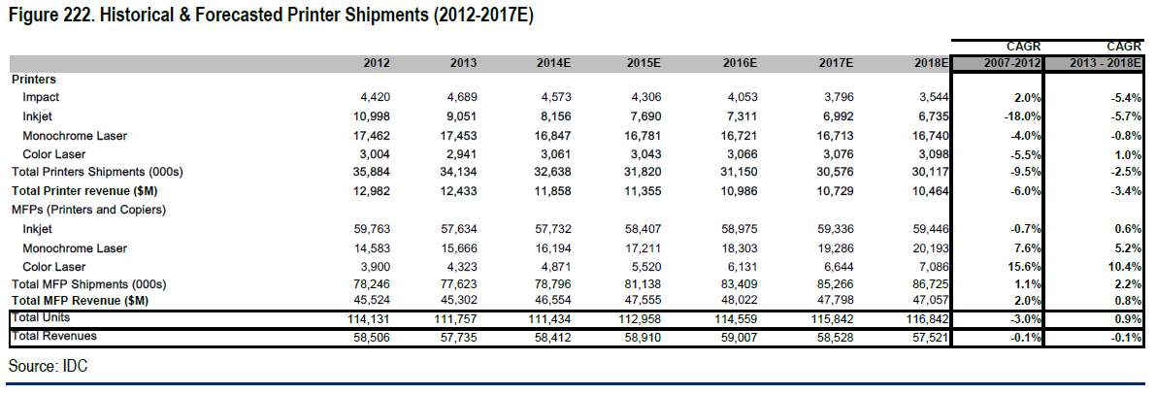
Analyzing Industries: Industry Framework
Combine Everything to Create Industry Forecasts:

Slide 21
Analyzing Companies
-Create a Company Profile
-SWOT Analysis
-Forecast Financial Metrics
-Calculate Valuation

Slide 22
Analyzing Companies: Company Profile
Determine Key Company Factors: Business Divisions, Products, Geographic Exposures, Strategies
Sources of Information: Start with Annual Report/10-K filing
Other Sources: Company Investor Relations Websites, Companies Earnings Calls, Morningstar, Reuters, Yahoo Finance, Seeking Alpha, Bloomberg
Key Things to Learn:
Company Overview: Strategy, Products, Business & Geographic Mix, Seasonality, Risk Factors.
Historical Financial Statements

Slide 23
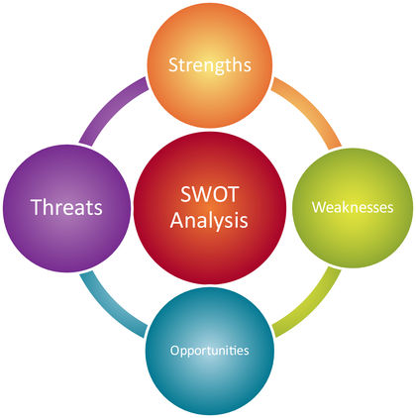
Analyzing Companies: SWOT Analysis

Slide 24
Analyzing Companies: SWOT Analysis
Strengths (Internal): Advantages, Capabilities, Resources, Expertise
Weaknesses (Internal): Vulnerabilities, Issues, Limitations
Opportunities (External): Market/Product Improvements & Developments
Threats (External): Obstacles, New Competition, Environmental Factors

Slide 25
Analyzing Companies: SWOT Analysis
Example:

Slide 26
Analyzing Companies: Forecast Financials
Start with Industry Framework
Project Company’s Sales Growth from Historical Data Using Learned Company Information from Profile & SWOT Analysis
Example: Industry expected to grow in line with Industrial Production;
Company Expected to Grow 2pts Faster due to unique product:
 | 2 yrs ago | 1 yr ago | Current YR Estimate | Next year Estimate | CY +2 Estimate | Notes
Expected Growth of IP | -1% | 0% | 2% | 2% | 1% | Based on your or others’ forecasts
Industry Sales Growth | -1% | 0% | 2% | 2% | 1% | Historically grows in line w/IP
Company A Sales Growth | 1% | 2% | 4% | 4% | 3% | Estimate 2pts faster growth
Company A Sales Projection | 100,000 | 102,000 | 106,080 | 110,323 | 113,633 | Sales estimate

Slide 27
Analyzing Companies: Forecast Financials
Project Other Items in Company’s Income Statement Using Other Information Learned from Industry & Company Analysis:
Example continued:
 | 2 yrs ago | 1 yr ago | Current YR Estimate | Next year Estimate | CY +2 Estimate | Notes
Company A Sales Projection | 100,000 | 102,000 | 106,080 | 110,323 | 113,633
Cost of Goods Sold | 50,000 | 49,500 | 106,080 * 49.2% = 52,191 | 110,323* 49.1% = 54,169 | 113,633 * 49.0% = 55,680 | Assume efficiencies in buying over time
Cost of Goods Sold Margin (COGS /Sales) | 50.0% | 49.5% | 49.2% | 49.1% | 49.0% | COGS divided by Sales
Gross Profit | 50,000 | 52,500 | 53,889 | 56,154 | 57,953 | Sales minus COGS
GP Growth Yr/Yr |  | 5.0% | 2.6% | 4.2% | 3.3%
Gross Margin | 50.0% | 50.5% | 50.8% | 50.9% | 51.0% | GP divided by Sales

Slide 28
Analyzing Companies: Forecast Financials
Example continued:
 | 2 yrs ago | 1 yr ago | Current YR Estimate | Next year Estimate | CY +2 Estimate | Notes
Gross Profit | 50,000 | 52,500 | 53,889 | 56,154 | 57,953
Other Costs Growth Yr/Yr | 35,000 | 35,700 +2.0% | 35,700 * 1.02 = $36,414 | 36,414 * 1.02 = $37,142 | $37,142 * 1.02= 37,885 | Prior Yr Cost Growth Assumed for Future
Operating Income | 15,000 | 16,800 | 17,475 | 19,012 | 20,068 | GP minus Other Costs
EBITDA | 20,000 | 21,800 | 22,475 | 24,012 | 25,068 | Assume D&A 1,000 per year
Interest | 3,000 | 3,000 | 3,000 | 3,000 | 3,000 | Use 10-K to calc; incl B/S & CF projection if possible
Net Income | 12,000 | 13,800 | 14,475 | 16,012 | 17,068 | OI minus Interest
Avg # of Shares | 8,000 | 8,002 | 8,040 | 7,950 | 7,900 | Garner from things you learn about co in filings
E.P.S. | $1.50 | $1.72 | $1.80 | $2.01 | $2.16 | NI divided by Avg Shares

Slide 29
Analyzing Companies: Valuation
Ideally Project Other Financial Statements Also.
Several Market Value/Stock Price Valuation Methods Exist:
Peer Analysis
Historical Analysis
Discounted Cash Flow/Dividend Models

Slide 30
Analyzing Companies: Valuation
Peer Analysis Example:
 | Stock Price | Next Year E.P. S. | P/E Ratio | Enterprise Value | Next Year EBITDA | EV/EBITDA
Company A | $20.00 | $2.00 | 9.5x | 209,000 | 24,012 | 8.7x
Peer A | $30.00 | $2.40 | 12.5x | 600,000 | 60,000 | 10.0x
Peer B | $16.00 | $1.33 | 12.0x | 285,000 | 30,000 | 9.5x
Peer C | $40.00 | $3.00 | 13.3x | 675,000 | 75,000 | 9.0x
If you believe Company A is going to have better products or strategy or management or growth over
time, you may conclude that the P/E Ratio Multiple the market ascribes to it will grow to one closer to
that of a high-quality peer:
Company A with an improved multiple:
Based on E.P.S.: $2.01 * 12x = $24.12; 21% price improvement over time.
Based on EV/EBITDA: 9.5 * 25,012 = $237,614 – Debt = 187,614 MV divided by shares = $23.60; +18%
-Other methods: P/B; P/S; P/CF

Slide 31
Analyzing Companies: Valuation
Historical Analysis Example:

Slide 32
Analyzing Companies: Valuation
DCF/DDM:
Estimate the Value of a Company using the Future Value of a Series of Cash Flows or Dividends:
CF1 = cash flow estimated
at end of year 1
CFn = terminal cash flow
value estimate
r = weighted avg cost of
capital

Slide 33
Analyzing Companies and Industries: Summary
Start with Industry Analysis to Build an Industry Framework.
Learn the Company’s Fundamentals and Key Drivers of Growth.
Use the Industry Framework to Knowledge of Company
Fundamentals to Project Future Financial Metrics.
Calculation the Market Value & Stock Price.

