Slide 1
Smart Women Securities Carnegie Mellon University September 29,2016
Jessica Bemer, CFA
Portfolio Manager and Principal
Snow Capital Management L.P.

Slide 2
Finding and Researching Investment Ideas
Investment Mandate
Candidates
Broad universe of securities
Watch List
Investment

Slide 3
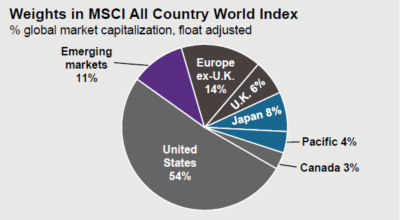
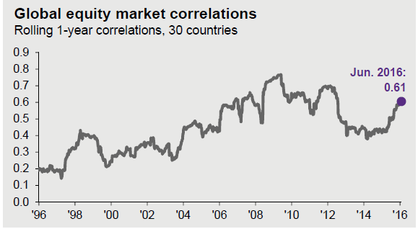
Begin with a Broad Universe of Securities
A Few of the World’s Largest Stock Indices
By Geography and Market Cap, the number of exchange-traded equities

Slide 4
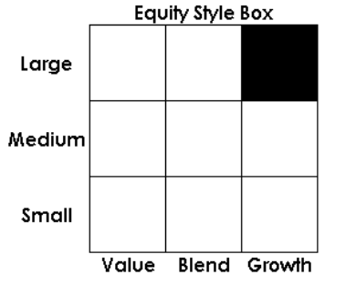
What is your Investment Mandate?
An investment mandate is a defined investment strategy used by financial institutions to achieve the aim of an investment fund. A strategy often includes:
A defined investment universe based on geography, market capitalization, sectors, and type(s) of securities
A specified Benchmark index
Conditions for short selling, hedges, and leverage
TIAA-CREF Large-Cap Growth Fund (TIRTX)
Principal investment strategies
Under normal circumstances, the Fund invests at least 80% of its assets in large-cap equity securities. The Fund will invest primarily in large-cap equity securities that the Fund’s investment adviser, Teachers Advisors, Inc. (“Advisors”), believes present the opportunity for growth. For purposes of the Fund’s 80% investment policy, “large-cap” securities are securities of issuers
with a capitalization equal to or greater than the top 80% of issuers by capitalization within the Russell 1000® Index at the time of purchase. Generally, these equity securities will be those of large capitalized companies in new and emerging areas of the economy and companies with distinctive products or promising markets. Advisors looks for companies that it believes have the
potential for strong earnings and/or sales growth, or that appear to be mispriced based on current earnings, assets or growth prospects. The Fund may invest in large, well-known, established companies, particularly when Advisors believes that the companies offer new or innovative products, services or processes that may enhance their future earnings. For purposes of the 80% investment policy, the term “assets” means net assets, plus the amount of any borrowings for investment purposes.
The Fund also seeks to invest in companies expected to benefit from prospective acquisitions, reorganizations, corporate restructurings or other special situations. The Fund may invest up to 20% of its assets in foreign investments.
The Fund’s benchmark index is the Russell 1000® Growth Index.

Slide 5
Candidates for Investment
Case Study: Large Cap Growth and Small Cap Value
Qualitative measures
News flow
Management meetings
Industry conferences
Meet or become a customer
LCG is looking for dynamic growth stories, good management teams, great brands, potential acquisitions.
SCV is looking for underpriced assets, defensible market share, turnaround stories, beaten down stocks.
Quantitative Screen
Filter a universe of stocks by valuation, cash flow, earnings growth, returns
LCG will screen for earnings and cash flow growth, high margins
SCV will screen for attractive valuation, strong cash flow, recent underperformance
Benchmark Analysis
Identify which Benchmark members fit your strategy
LCG: 285 stocks in the benchmark over $10 B
SCV: 1298 stocks in the benchmark with MC between $100 MM and $3 B
Large Cap Growth:
US Equities
Market Cap over $10 B
Benchmark: Russell 1000 Growth
Small Cap Value:
US Equities
Market Cap btw $100 MM and $3 B
Benchmark: Russell 2000 Value
All investment mandates have the same goal: Stay true to the strategy and BEAT THE BENCHMARK

Slide 6
Tools for Identifying Investment Candidates
Qualitative measures
News flow
Management meetings
Industry conferences
Meet or become a customer
News sources: WSJ, Bloomberg, Barron’s, Business Insider
Twitter feeds: @marketcurrents, @fundstrat, @cnbcnow, @optionshawk, @RBAdvisors, @openoutcrier,
Free newsletter: dailyshotletter.com
Free Radio App: Bloomberg Radio, for Bloomberg Surveillance with Tom Keene on weekday mornings
Bloomberg Functions
MOST: Biggest moves up / down, highest volume
WEI: World Equity Indices
Quantitative Screen
Filter a universe of stocks by valuation, cash flow, earnings growth, returns
Bloomberg Functions
EQS: Equity Screening
RV: Relative Valuation by Industry / Sector
Benchmark Analysis
Identify which Benchmark members fit your strategy
Bloomberg Functions
RV: Relative Valuation by Industry / Sector
CCB: Company Classification Browser
RLG Index MEMB: List of index members, replace RLG with any other index ticker

Slide 7
Developing a Watchlist
Now that you have used your investment mandate to build a list of candidates, it’s time to refine that list further by reviewing each company.
Your goal will be to sort the candidate list by fit with the investment mandate. Stocks that are in obvious conflict with the strategy will be eliminated, while the most suitable names will join the Watchlist.
Research the Company
Read quarterly reports and annual reports
https://www.sec.gov/edgar/searchedgar/companysearch.html
Listen to most recent quarterly webcast on company’s website
Consider competitive position: Michael Porter’s 5 Forces model
Build a financial model: Understand the drivers to revenues, margins, earnings
Bloomberg Functions:
CN: Company News
EVT: Company Events
DS: Document Search
SPLC: Supply Chain analysis
FA: Financial Analysis
DDIS: Debt distribution
MGMT: Company Management
Research the Stock
Read any available analyst reports. Ignore the Buy/Sell/Hold rating, but use the detailed data. Look for reasons why that analyst’s opinion might change.
Look at major moves in the stock, and try to understand why they occurred. Was there an earnings miss, a new product introduction, a management change?
Compare current valuation with long-term median/average, and current peer valuations.
Bloomberg Functions:
GP: Line Chart of security price
EM: Valuation and consensus estimates
EE HIST: Changes in consensus estimates
GE: Historic valuation analysis
EV: Enterprise Value
HDS: Security Ownership
“If you’re prepared to invest in a company, then you ought to be able to explain why in simple language that a fifth grader could understand, and quickly enough so the fifth grader won’t get bored.” – Peter Lynch

Slide 8
Choose an Investment from your Watchlist
You have developed a Watchlist of securities that fit your investment mandate. Now we will consider which names on the list have the most attractive upside with the least down side.
Determine the Upside
Select a target EPS based on a financial model with historic earnings and your best estimate of future earnings.
Maintain a list of assumptions that were used to build your future estimates.
Choose a target valuation based on a combination of historical averages, peers, and changes in the business model.
Your downside target is equal to EPS x PE
Upside is the percentage difference between the target valuation and today’s stock price.
Determine the Downside
Select a target EPS based on a reasonable downside expectation.
Maintain a dynamic list of risks that might cause you to change your assumptions.
Choose a target downside valuation based on a combination of historical averages, peers, and changes in the business model.
Your downside target is equal to EPS x PE
Downside is the percentage difference between the target downside valuation and today’s stock price.
Assign a probability to the Upside and Downside scenarios. This is a test of how generous you have been with your assumptions. Probabilities of either 95% or 5% are not realistic.
The Expected Return of a stock = Upside x probability + Downside x (1-probability)
Rank your Watchlist by Expected Return. Select the stock with the highest risk-adjusted return.
“We don’t have to be smarter than the rest. We have to be more disciplined than the rest.” – Warren Buffet
Are we done yet? No, of course not!

Slide 9
Maintain your Watchlist, Admit you are wrong
“There is nothing riskier than the widespread perception that there is no risk.” Howard Marks
Maintain your Watchlist
On a regular basis, you should refresh your Watchlist by starting from the very beginning of the research process.
Review quarterly and interim reports.
Update your model and assumptions.
Make changes to target prices and probabilities.
Admit you are wrong
Being wrong doesn’t mean that you have made a mistake. Investing is a dynamic process, and you must embrace change.
Recognize when your assumptions are wrong and address changes immediately.
Remove Watchlist names that are no longer a good fit with the strategy.
Do not hide missed expectations with more generous assumptions. When your revenue assumptions come down, do not overcompensate in other parts of the income statement.
Talk it out: Early in your career, use your colleagues as soundboards, ask for advice, explain your thought process.
Rules of the Road Ahead
Ask questions and listen to the answers. Do not hesitate to ask “dumb questions.”
Accept new challenges and new assignments.
Communicate your workload
Ask for specific tasks when you need work
Ask for specific deadlines so you can prioritize tasks
Network, but remember your responsibility to the firm.
Never put in writing something that you don’t want everyone to read.
Bring a cardigan, a water bottle and snacks! Remember that you will be sitting in a cold office for long hours.

Slide 10
Thank you, and good luck!
Jessica Bemer, CFA
Portfolio Manager and Principal
Snow Capital Management L.P.

